Slide 1
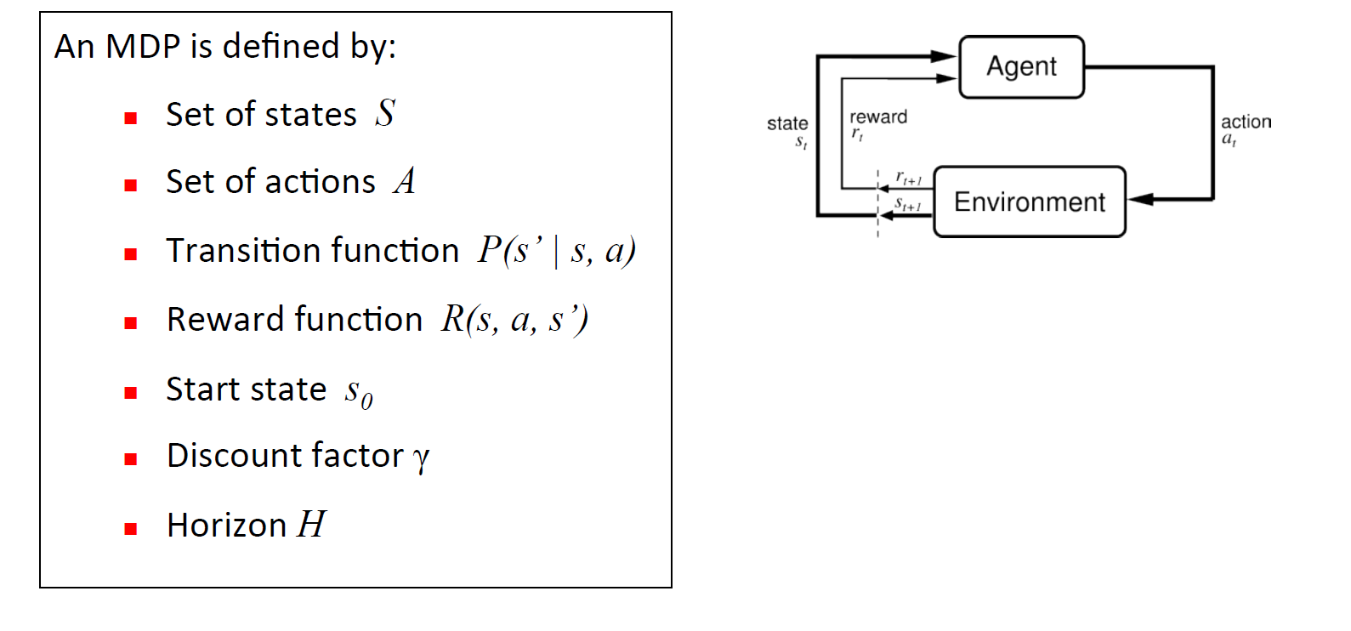

Slide 2
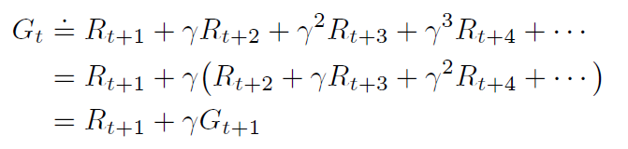
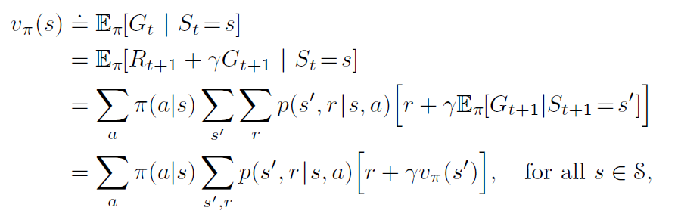
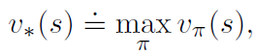
Total global reward
Bellman Equation

Slide 3
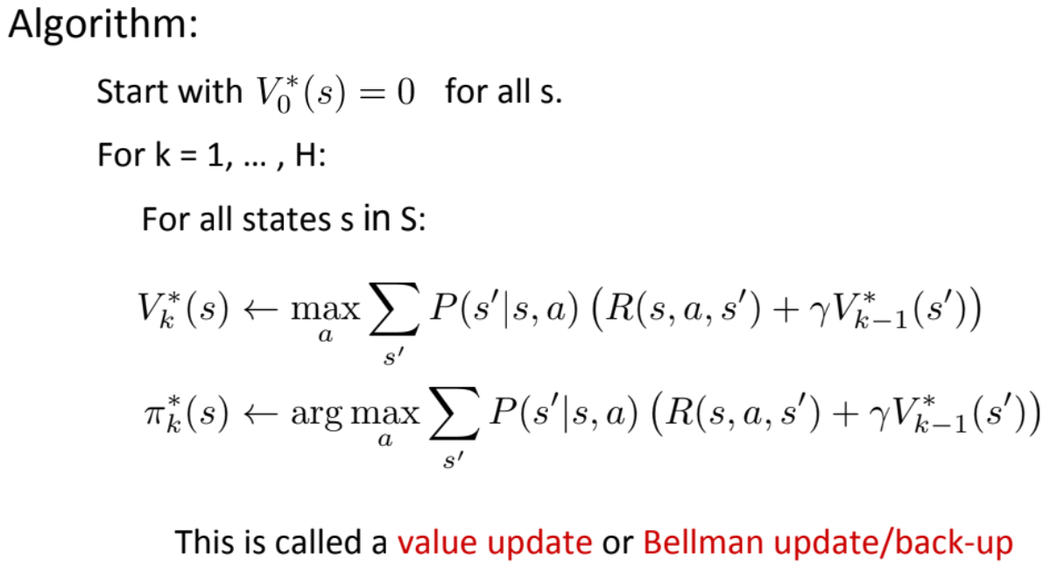
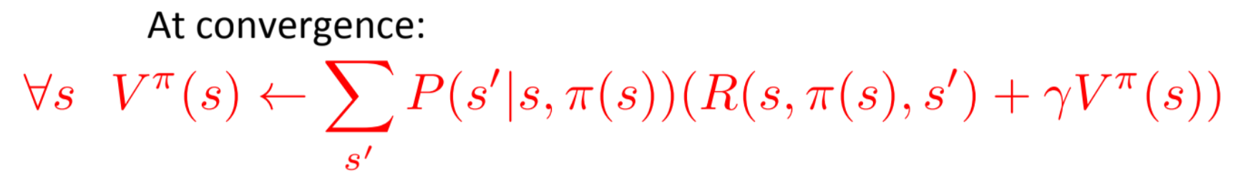
Value Iteration
For each time step k
Update value of all possible states and update policy.
Update value
Update policy

Slide 4
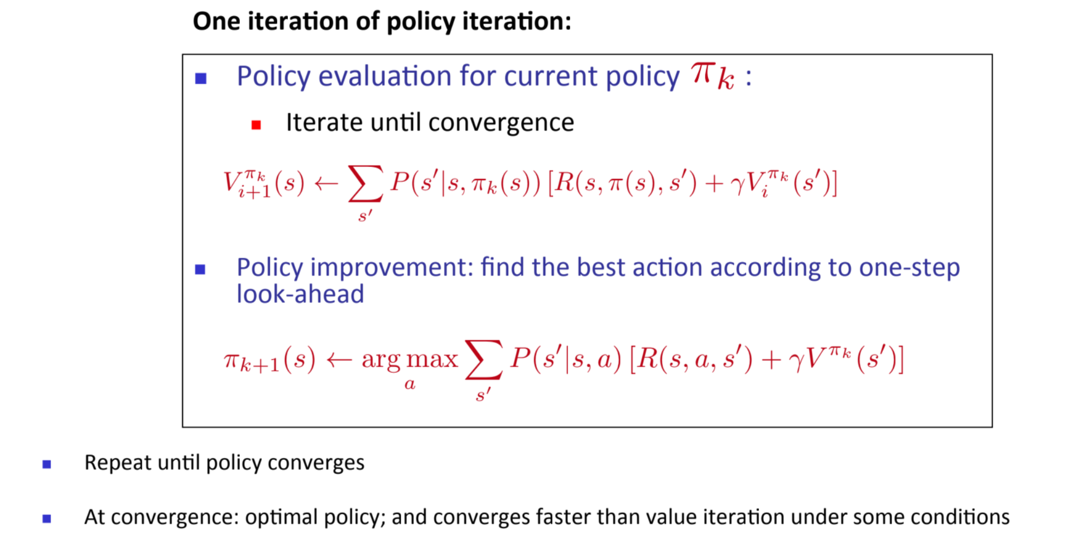
Policy Iteration
Choose an initial policy
Update values until convergence
Update policy

Slide 5
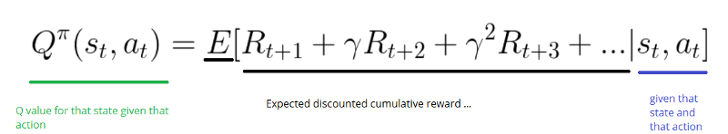
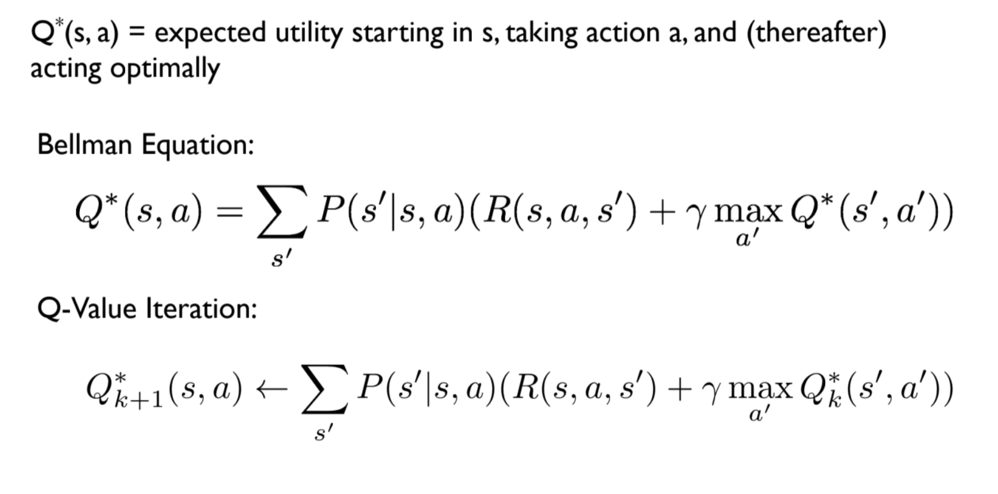
Q-Value

Slide 6
Key points
For value or policy iteration we need to know
Transition function p(s’ | s, a) and
Reward function r(s’, s, a)
Hence, is model based approach
Iterative methods, can be solved by dynamic programing
Fully deterministic
Explore all possible states

Slide 7
Model Free Approach
We don’t know transition function or/and reward function
2 main approaches
Monte Carlo approach
Learn value v(s) by taking average over
Temporal difference approach
Learn by exploring

Slide 8
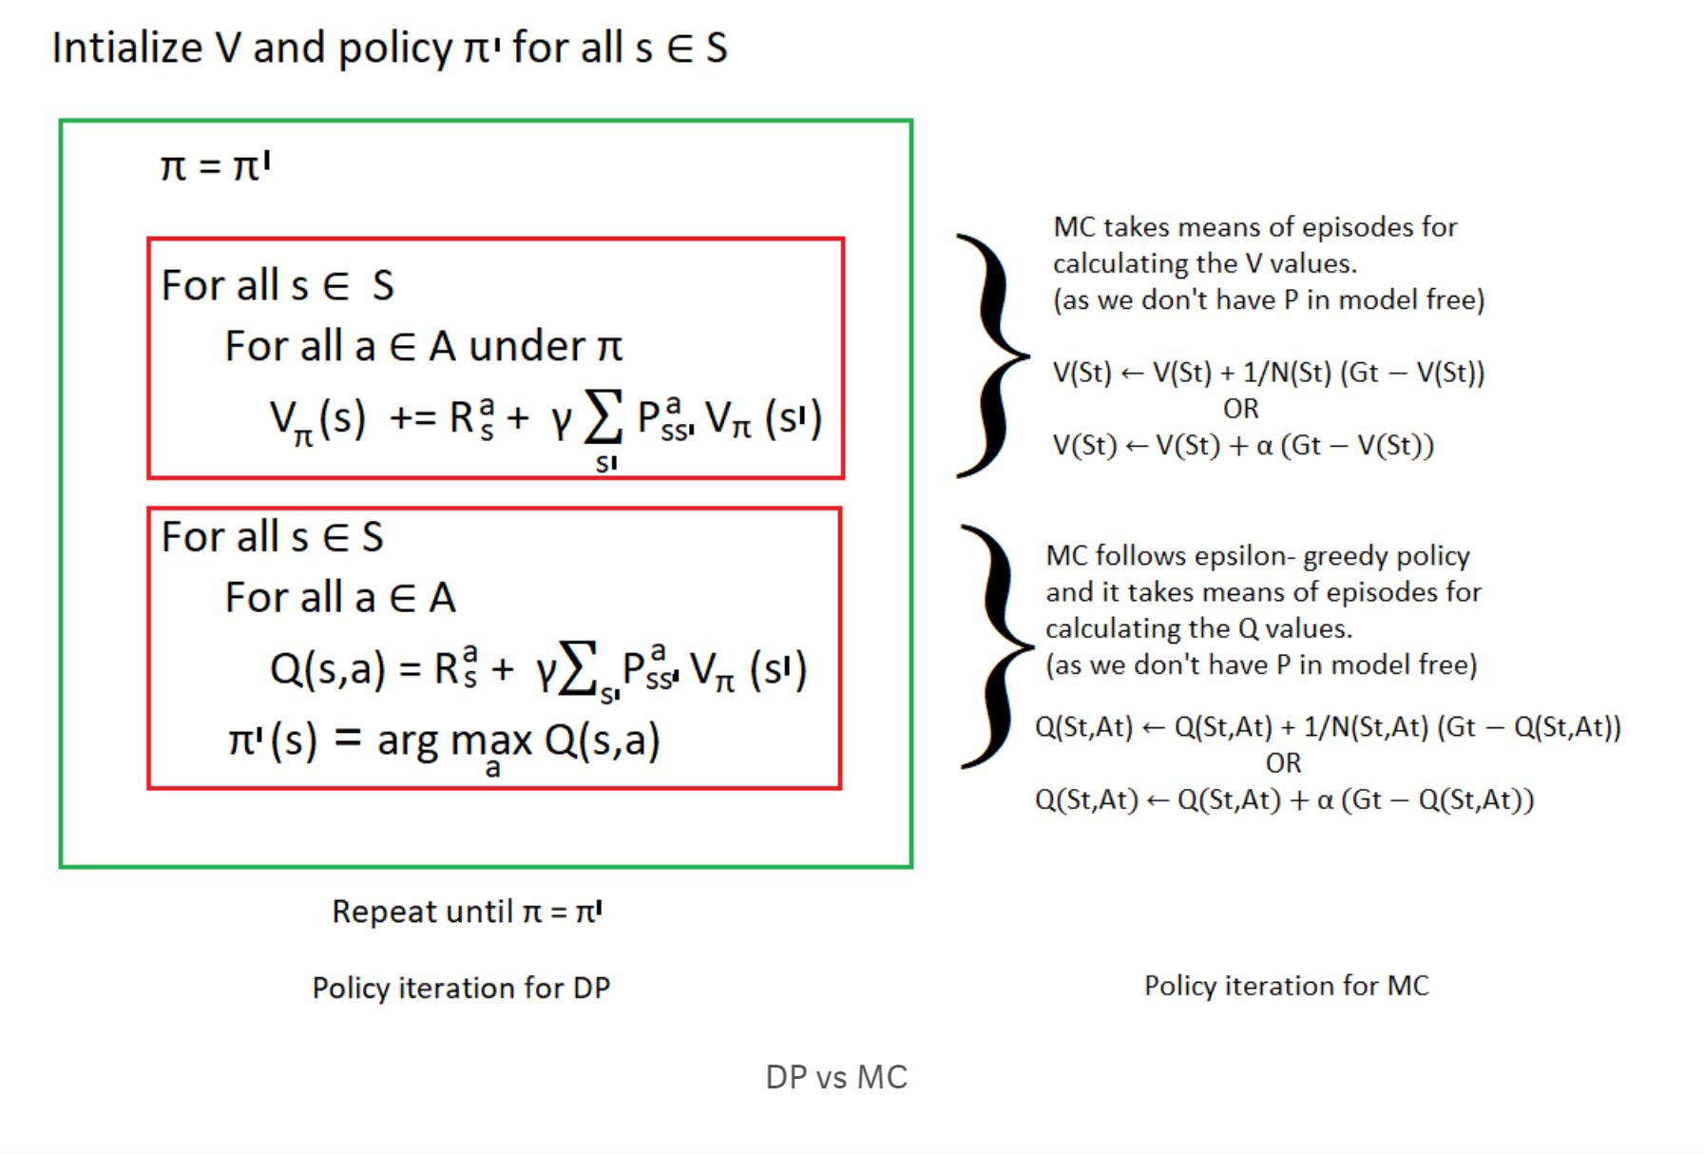
Policy Iteration

Slide 9
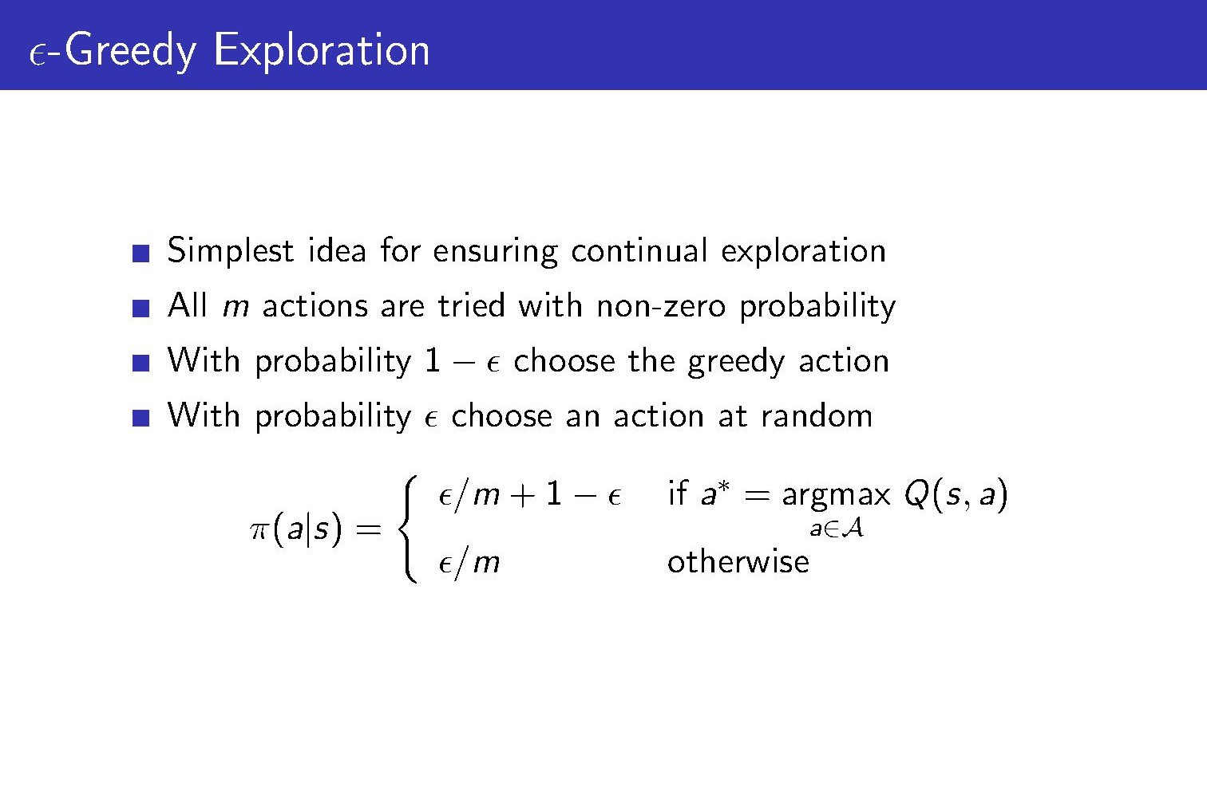
Exploration vs exploitation

Slide 10
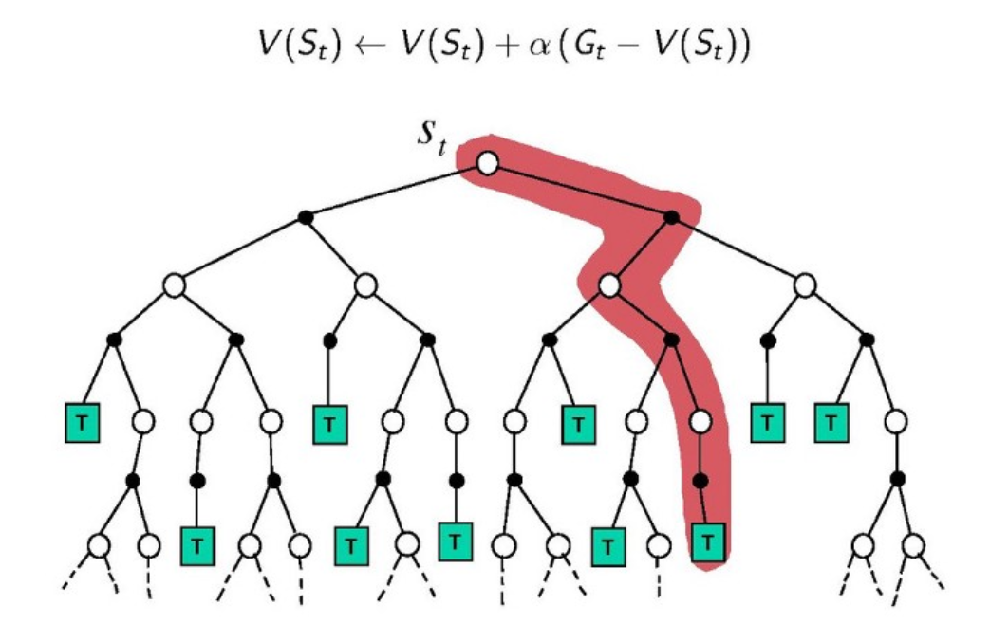
Monte Carlo Approach

Slide 11
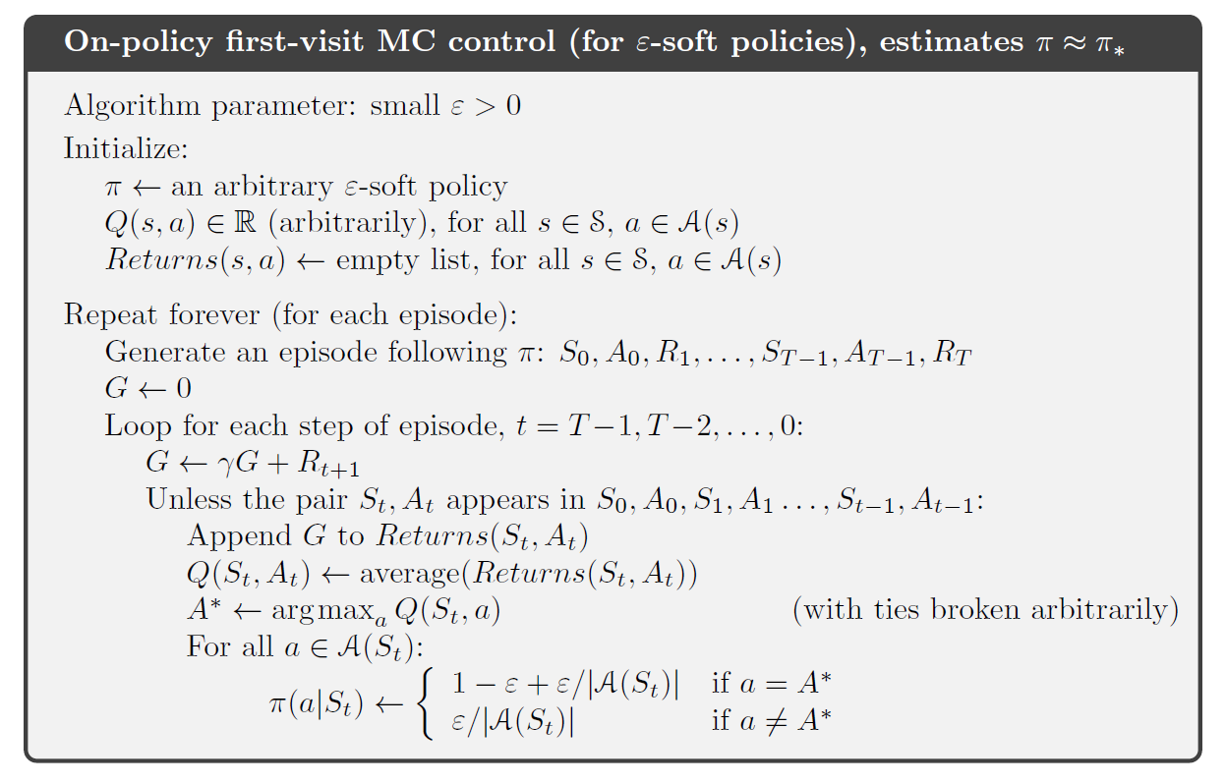
Explore, by generating episodes

Slide 12
Key points
Iterate over only those states which appears in episode.
Value is estimate by an average over total reward.

Slide 13
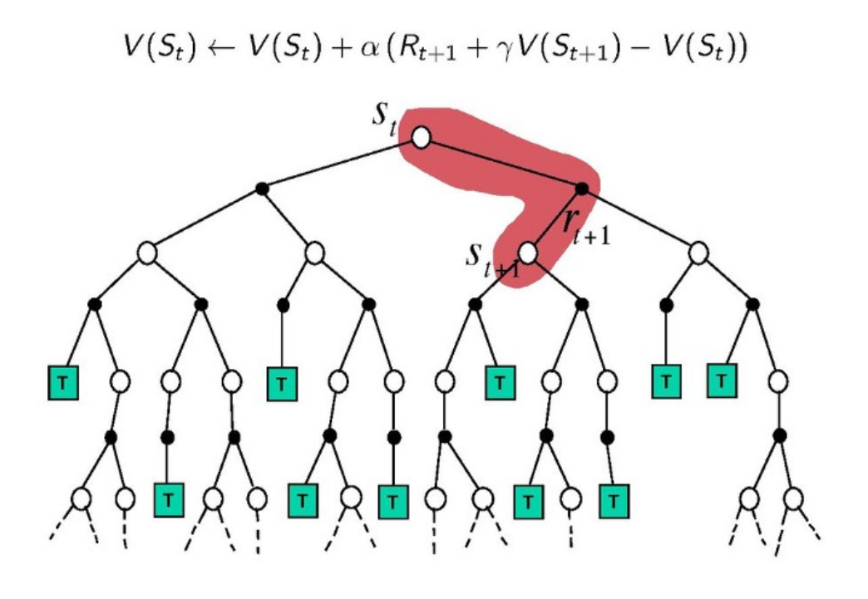
Temporal difference approach
Monte Carlo + Dynamic Programming
Just like Dynamic Programming → TD methods boot strap , meaning it will not wait until the end of the episode to update the expected future reward estimation(V) , it will only wait until the next time step to update the value estimates.

Slide 14
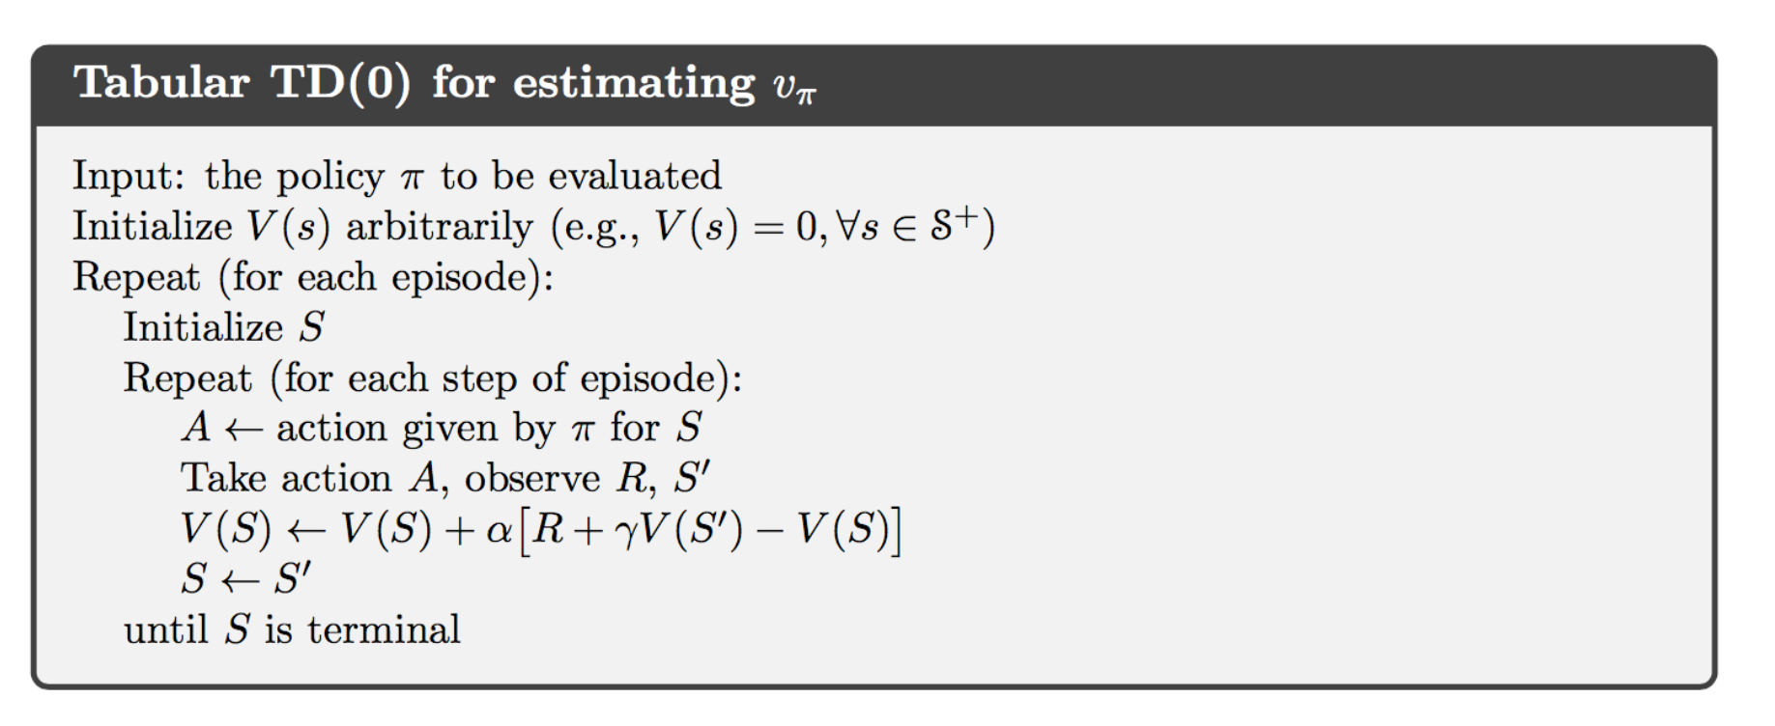
Temporal Difference
We start with a policy

Slide 15
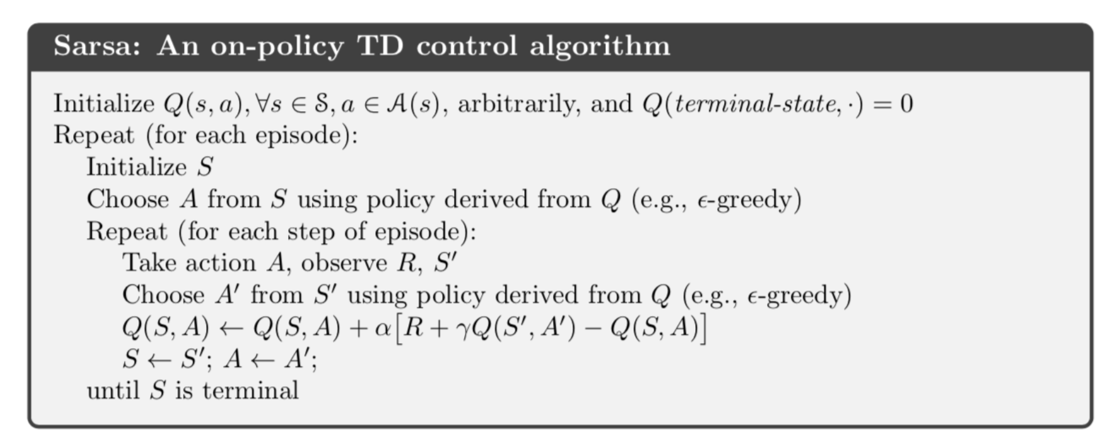
Temporal Difference
On policy learning method , means it uses the same policy to choose the next action A`

Slide 16
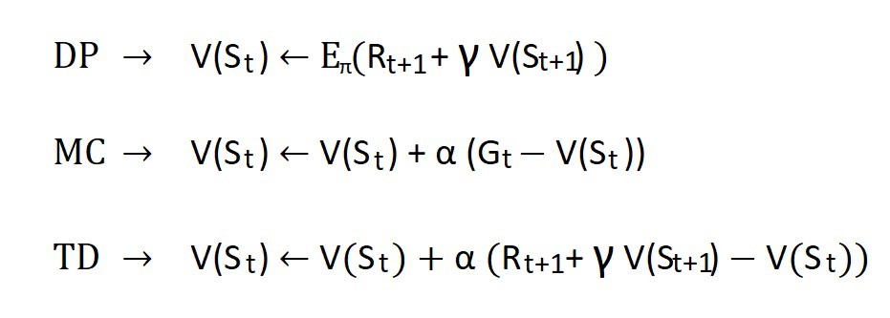
Comparison

Slide 17
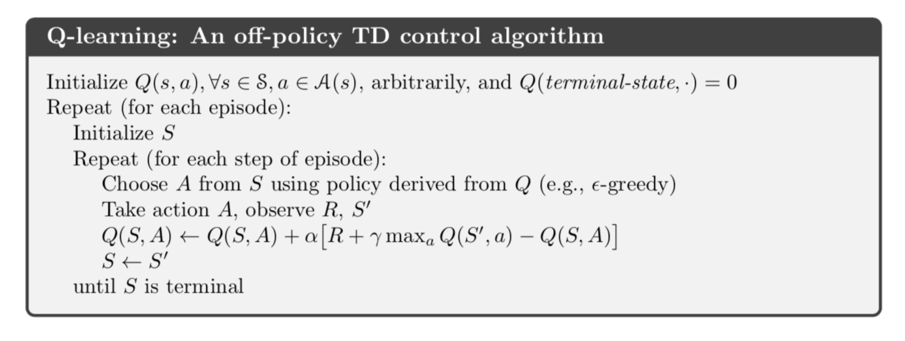
Q-Learning
Off-policy TD algorithm
Off policy learning method , means, it uses the target policy (greedy) to choose the best next action A` while following the behavior policy (epsilon-greedy)

Slide 18
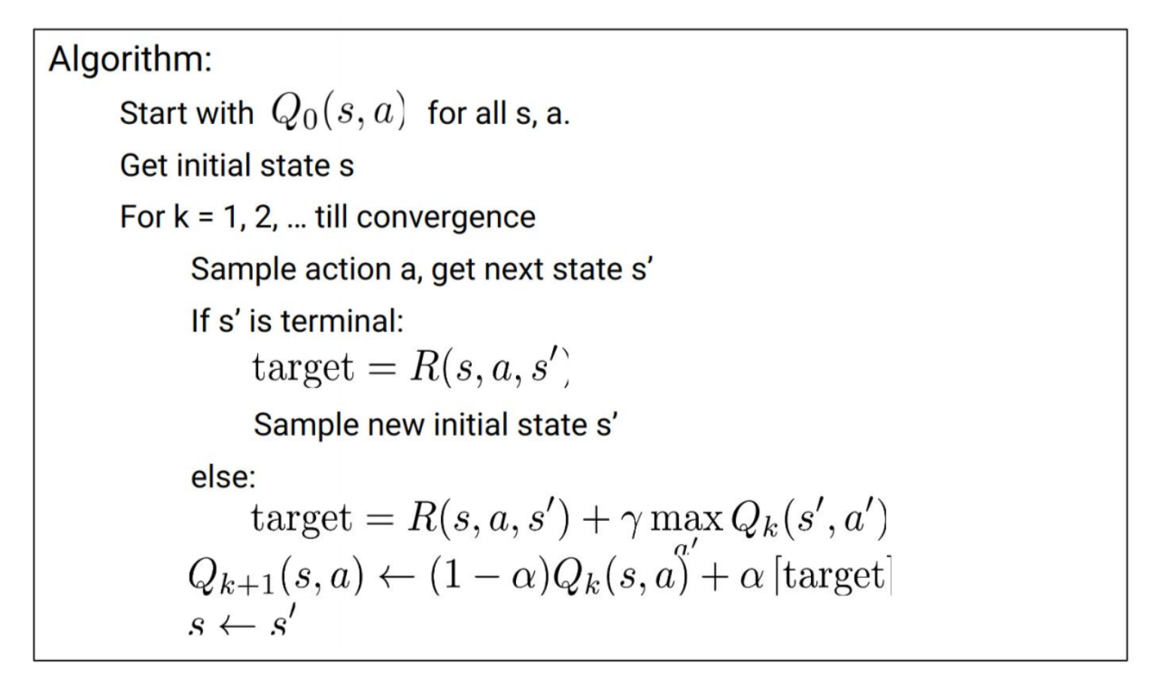
Tabular Q-learning
Derive target!!!!

Slide 19
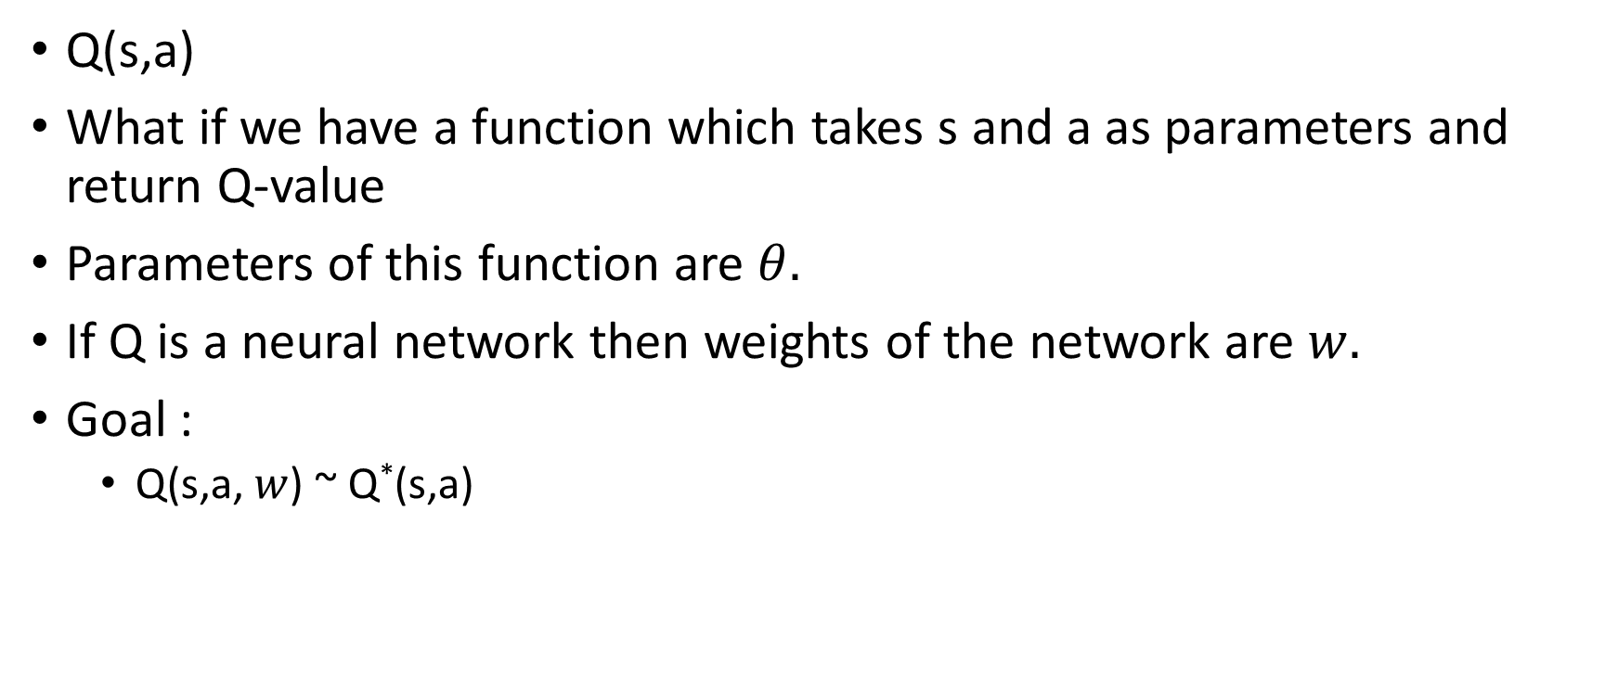
Approximate Q-learning
Q(s,a)
What if we have a function which takes s and a as parameters and return Q-value
Parameters of this function are $θ.$
If Q is a neural network then weights of the network are $w.$
Goal :
Q(s,a, $w$) ~ Q*(s,a)

Slide 20
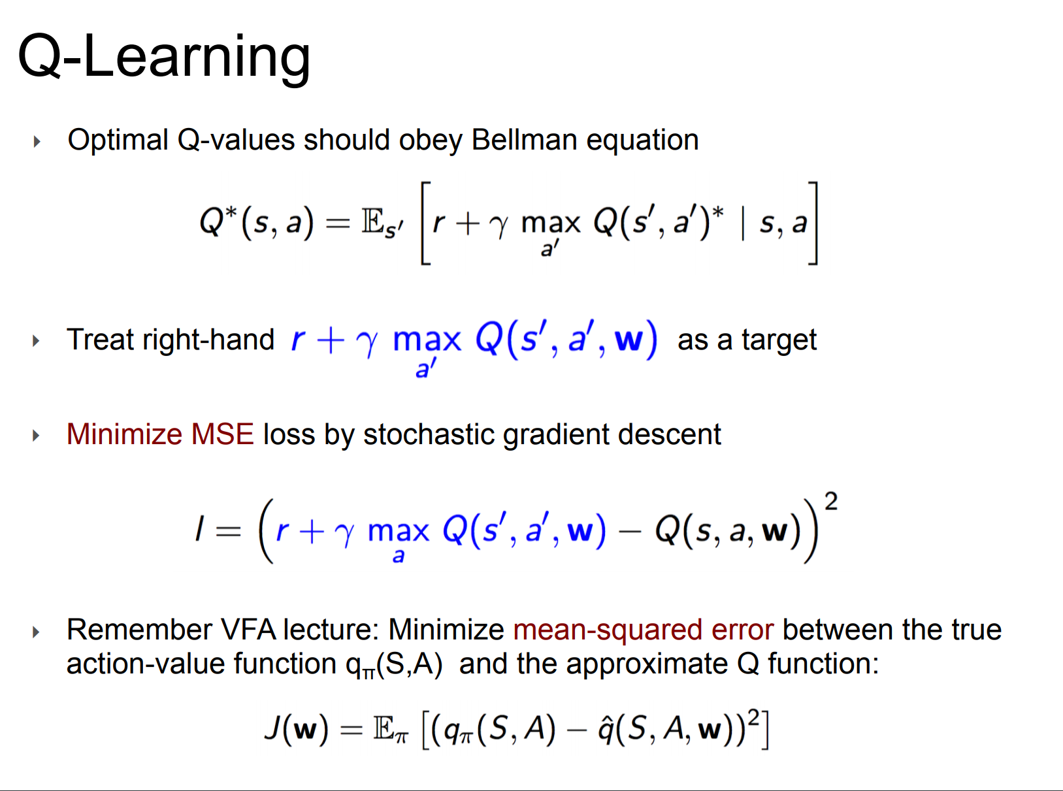

Slide 21
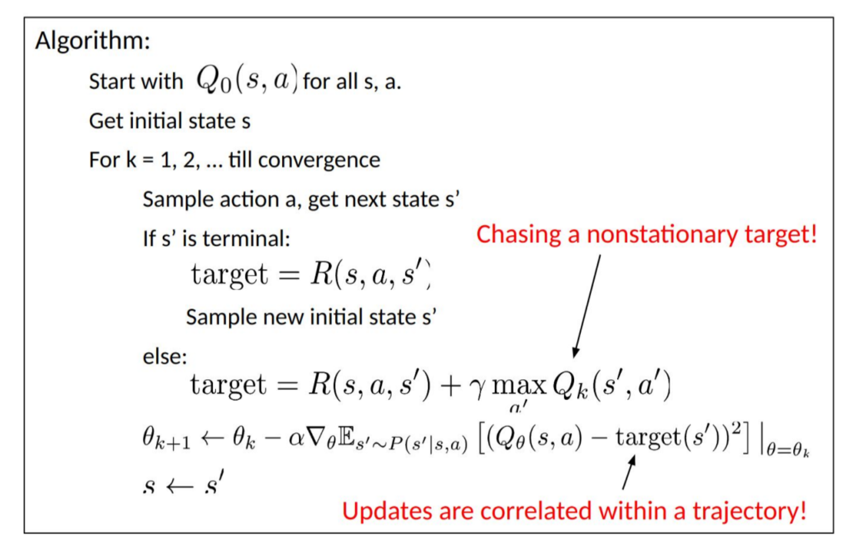
Approximate Q-Learning

Slide 22
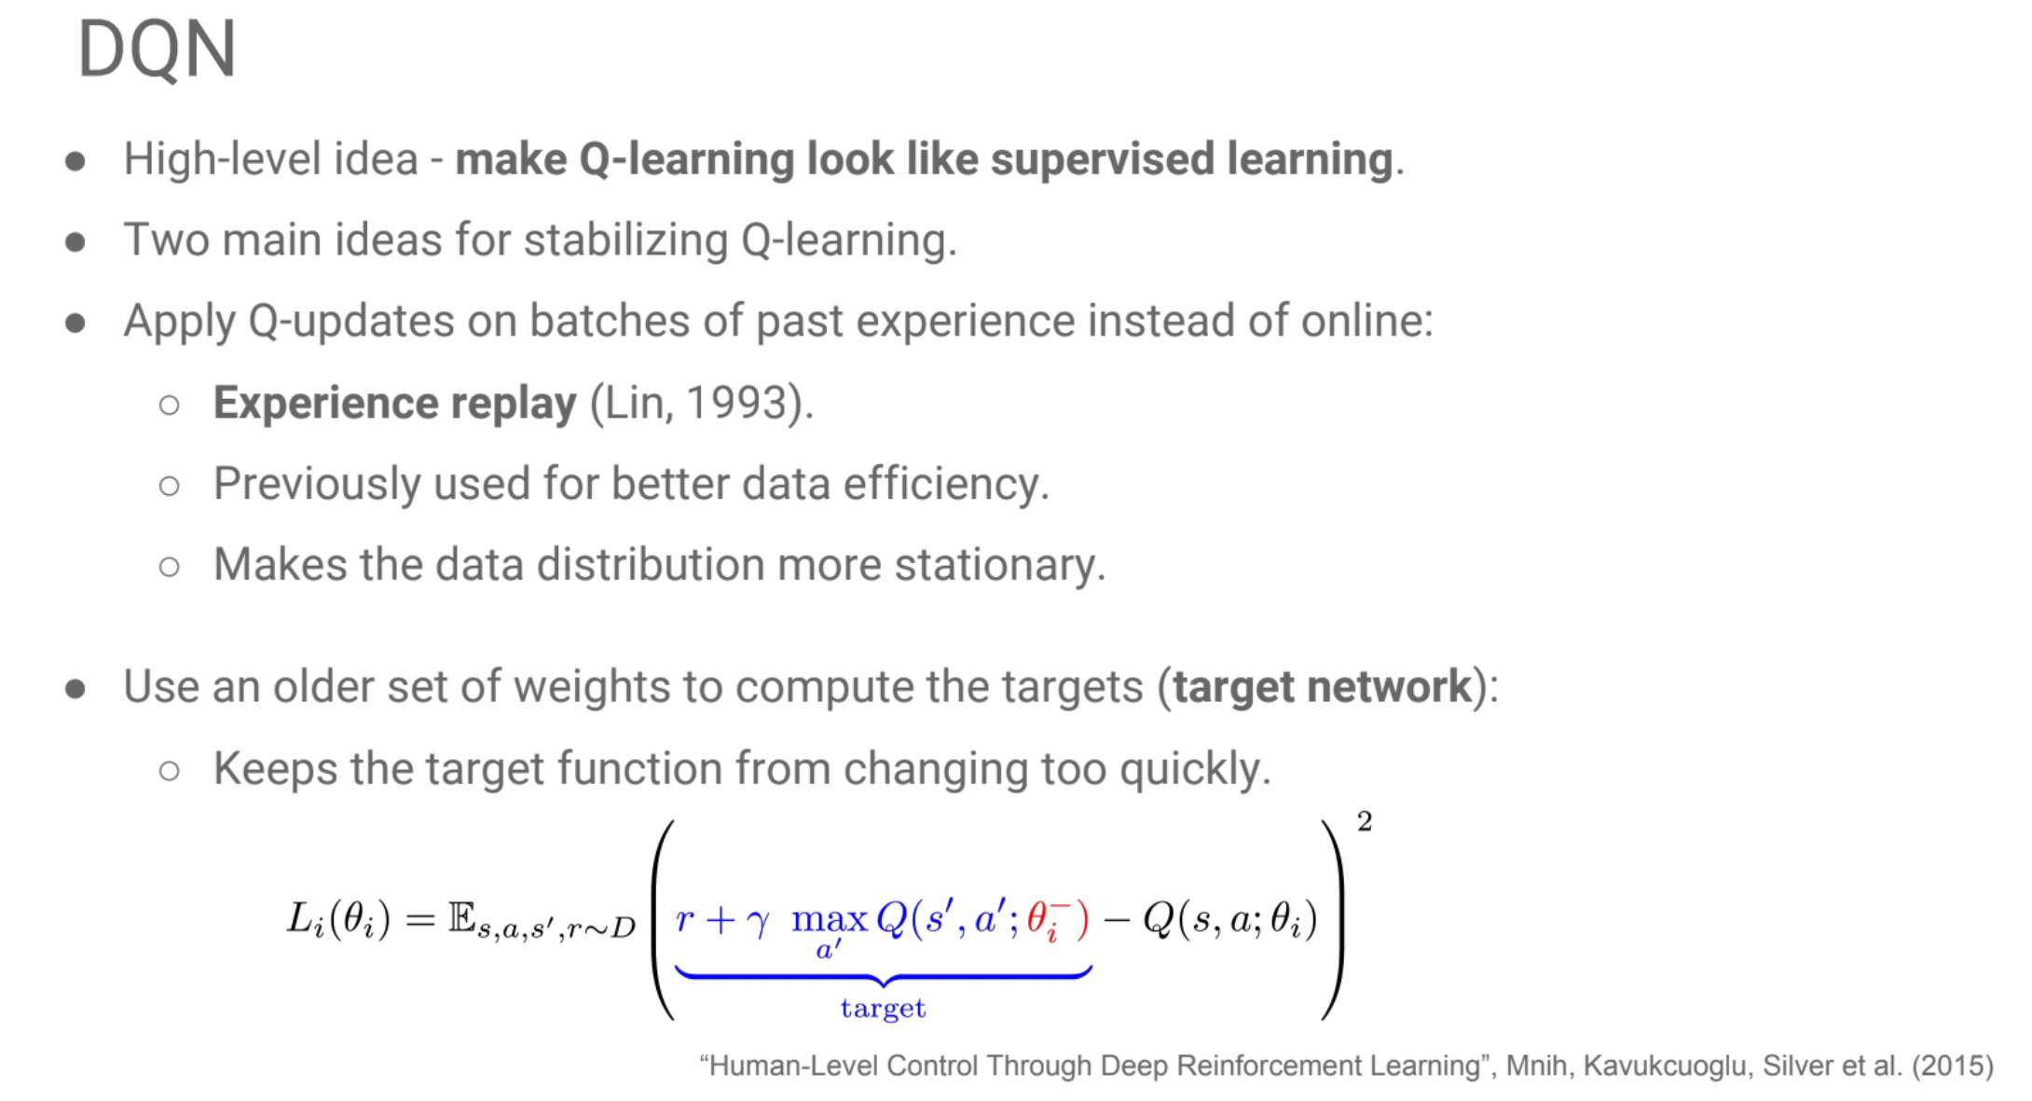

Slide 23
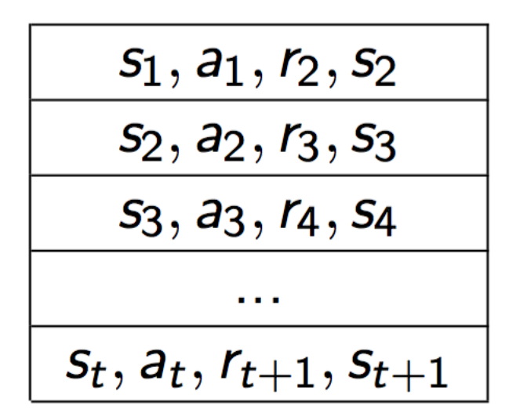
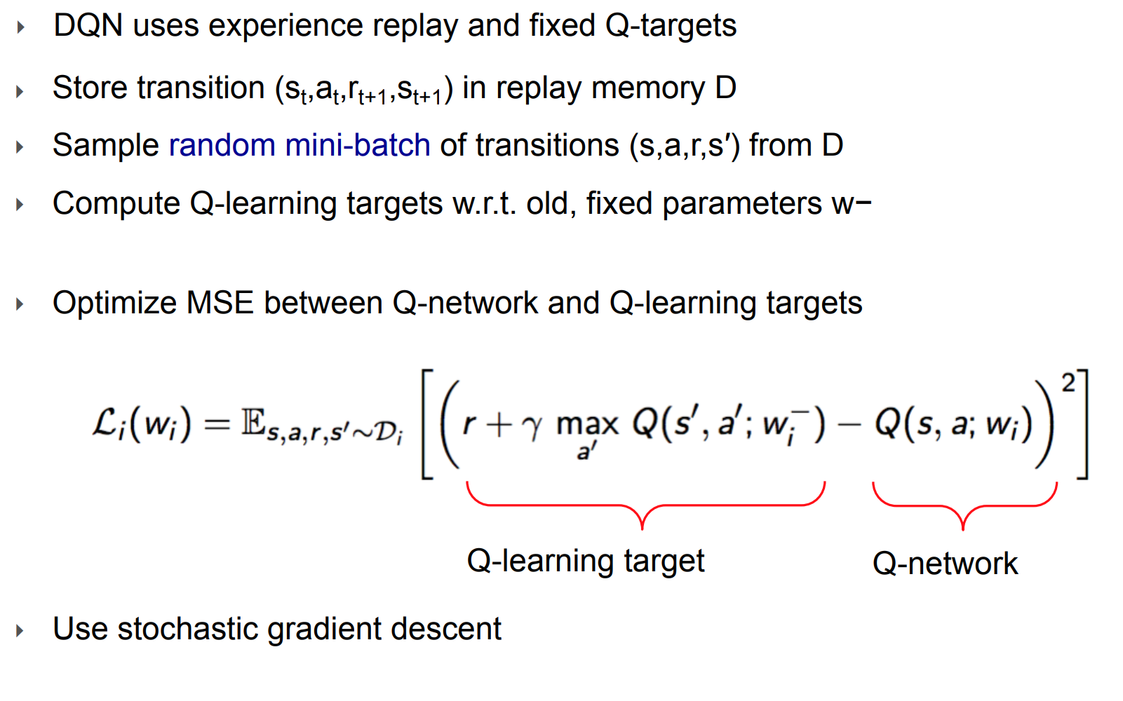
Experience replay

Slide 24
